Slide 1
the Death of Christ
REMEMBER
Romans 14:8-9
Notes:
Preached at West Side church of Christ on February 3, 2013 AM
Based on outline from Joe Price’s The Spirit’s Sword (October 28, 2012)
Print Slides: 1,10,12

Slide 2
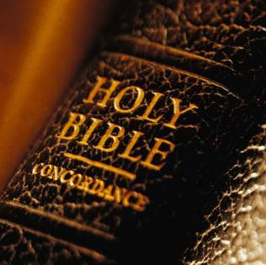
Romans 14:8-9
For if we live, we live to the Lord; and if we die, we die to the Lord. Therefore, whether we live or die, we are the Lord’s. ⁹ For to this end Christ died and rose and lived again, that He might be Lord of both the dead and the living.

Slide 3
Remember the Death of Christ
As the sacrifice for our sins
Galatians 1:3-5; Romans 5:8; Isaiah 53:5

Slide 4
Galatians 1:3-5
Grace to you and peace from God the Father and our Lord Jesus Christ, ⁴ who gave Himself for our sins, that He might deliver us from this present evil age, according to the will of our God and Father, ⁵ to whom be glory forever and ever.

Slide 5
Romans 5:8
But God demonstrates His own love toward us, in that while we were still sinners, Christ died for us.

Slide 6
Isaiah 53:5
But He was wounded for our transgressions, He was bruised for our iniquities; The chastisement for our peace was upon Him, And by His stripes we are healed.

Slide 7
Remember the Death of Christ
As the sacrifice for our sins
Galatians 1:3-5; Romans 5:8; Isaiah 53:5
As the ONLY means of remission of our sins
Revelation 5:1-5 (READ); Hebrews 9:22; Hebrews 10:4,10,18

Slide 8
Hebrews 9:22
And according to the law almost all things are purified with blood, and without shedding of blood there is no remission.

Slide 9
Hebrews 10:4,10,18
(4), For it is not possible that the blood of bulls and goats could take away sins.
(10), By that will [2nd covenant] we have been sanctified through the offering of the body of Jesus Christ once for all.
(18), Now where there is remission of these, there is no longer an offering for sin.

Slide 10
Remember the Death of Christ
As the sacrifice for our sins
Galatians 1:3-5; Romans 5:8; Isaiah 53:5
As the ONLY means of remission of our sins
Revelation 5:1-5 (READ); Hebrews 9:22; Hebrews 10:4,10,18
An observance of the Lord’s Supper helps us to remember
1 Corinthians 11:23-26

Slide 11
1 Corinthians 11:23-26
For I received from the Lord that which I also delivered to you: that the Lord Jesus on the same night in which He was betrayed took bread; ²⁴ and when He had given thanks, He broke it and said, “Take, eat; this is My body which is broken for you; do this in remembrance of Me.” ²⁵ In the same manner He also took the cup after supper, saying, “This cup is the new covenant in My blood. This do, as often as you drink it, in remembrance of Me.” ²⁶ For as often as you eat this bread and drink this cup, you proclaim the Lord’s death till He comes.

Slide 12
“For this reason I will not be negligent to remind you always of these things, though you know and are established in the present truth.” (2 Peter 1:12) We should always be mindful of our Lord’s sacrificial death
CONCLUSION

